Slide 1

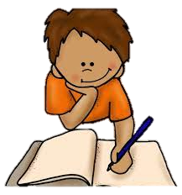



All About Me
Year 7 Health
Lesson 5
2024

Slide 2

In the first 5 minutes of each lesson you will complete your revision page, you will find these throughout your booklet.
The revision page consists of three questions. It will need to be completed in detail. One word answers will not be accepted.
The three questions :
What two concepts or ideas did I learn in class last week?
What did I find interesting about last week’s lesson? Provide a specific example.
Any questions or new words you have learnt?
The teacher will go over this each lesson with you to see what you have learnt. It is a great way for you to revisit content and test your memory.
Notes:
Pg16

Slide 3
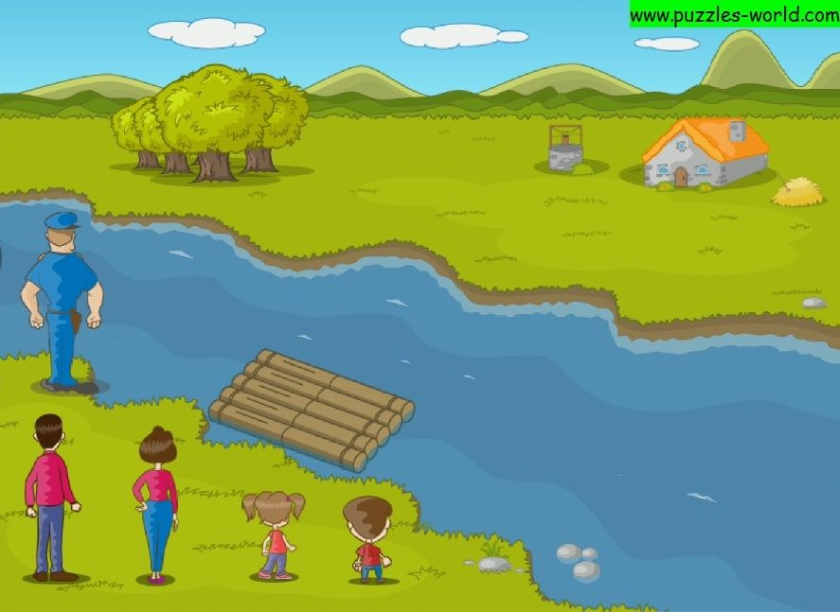
HOOK: Building resilience
River crossing (Pg. 17).
Form small teams of 2 to 5 people.
Each team is to work together to solve the puzzle outlined below:
“Using a small rowboat, how can your group transport a chicken, a fox and a bag of corn to the other side of the river in as few moves as possible?”
Your solution must acknowledge three critical parameters:
    The rowboat can only carry one person and one item at any point in time.
    The fox and chicken cannot be left alone; and
    The chicken and the bag of corn cannot be left alone.
Describe the step-by-step solution to get all three items safely to the other side of the river.
Notes:
Online option - https://www.transum.org/software/River_Crossing/
To begin, the woman and the chicken cross the river together. The fox and corn are safe together.
Once on the other side, the woman leaves the chicken and returns to the fox and corn. She takes the fox across the river, and since she can’t leave the fox and chicken together, she brings the chicken back with her (that’s the trick which many groups do not think of.)
She cannot leave the chicken with the corn, so she leaves the chicken and rows the corn across the river and leaves it with the fox.
Finally, she returns to pick up the chicken and rows across the river one last time.

Slide 4

HOOK: Reflection (Pg. 17-18).
Answer the following questions in your workbooks:
How did you feel when you encountered obstacles or challenges during the river crossing puzzle? How did you handle those feelings?
What strategies did you use to overcome difficulties or setbacks while trying to find the solution?
Did you encounter any moments of frustration or uncertainty? How did you persevere and keep going?
Were there any disagreements or conflicts within your team? How did you resolve them and continue working together?
Did you encounter any unexpected surprises or solutions that you hadn't considered? How did you adapt and adjust your approach?

Slide 5
Activity 1: (Pg. 18).
Skills needed to build resilience
Problem-Solving Skills: Break down the puzzles into smaller components and analyse each part individually. Then develop step-by-step plans or strategies to tackle each component effectively.
Perseverance: Remind Puzzles often require trial and error. Persist through challenges, learn from mistakes, and keep trying different approaches until they find the solution.
Positive Mindset: Maintain a positive mindset throughout the puzzle-solving process. View challenges as opportunities for growth and learning, rather than becoming discouraged by setbacks.
Collaboration and Communication: Share ideas, listen to each other's perspectives, and work together to find solutions. Effective communication and collaboration can enhance problem-solving abilities and resilience.
Flexibility and Adaptability: Sometimes the initial strategy may need adjustment or modification. Be flexible and open to trying new approaches if the current one isn't working effectively.
Notes:
Assessment 2 related
Fill in the blanks

Slide 6
Activity 1: (Pg. 18).
Skills needed to build resilience
Time Management: Give yourself sufficient time for planning, execution, and reflection. Pace yourself and avoid rushing through the puzzle, as it may lead to errors or oversights.
Self-Reflection: Reflect on your progress and problem-solving strategies periodically. This self-reflection can help you identify areas of improvement, recognize your strengths, and adjust your approach as needed.
Celebrating Small Wins: Acknowledge and celebrate your achievements along the way, even if you haven't fully solved the puzzle yet. Recognizing small wins can boost motivation, confidence, and resilience.
Seeking Help and Support: It’s okay to ask for help or guidance when faced with challenges. Seek assistance from peers, teachers, or other resources to gain new perspectives and insights.
Notes:
Assessment 2 related
Fill in the blanks

Slide 7
Activity 2:
Over the next few slides, you have an option for a class activity:
Option 1:
  Bridge Crossing Activity + Reflection.
OR
Option 2:
  Rock off competition (scissors, paper, rock) + Reflection.
Notes:
Choose between one of the activities above. Slides explaining each follow.

Slide 8
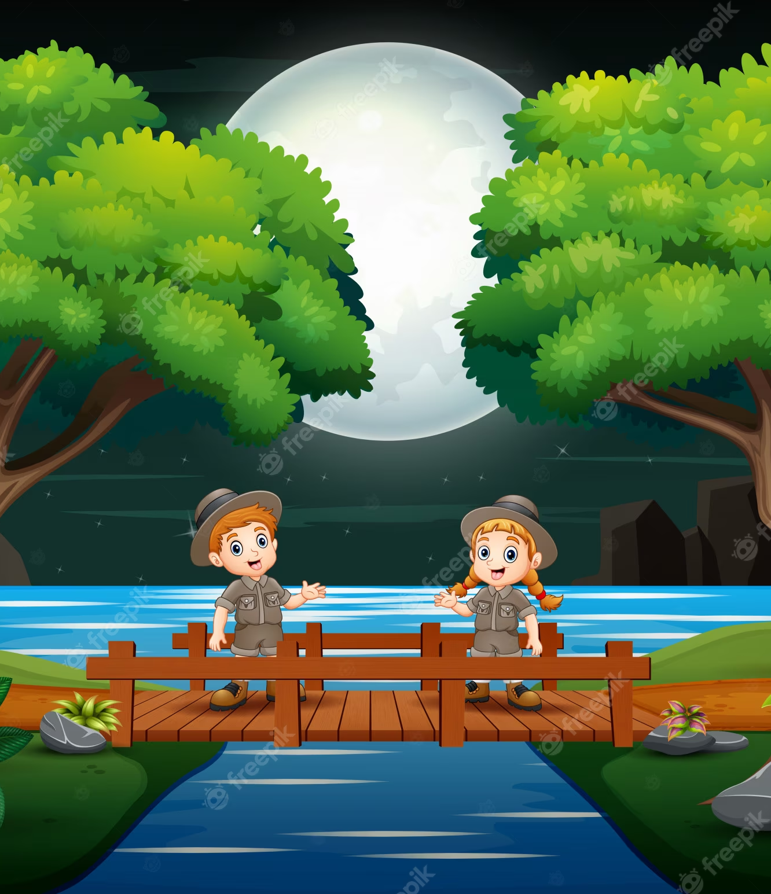
Option 1:
Building resilience –
Bridge crossing (Pg. 19).
Now that you have been given some skills to build your resilience,
can you now solve the second riddle??
Four people come to a river in the night. There is a narrow bridge,
but it can only hold two people at a time.
They have one torch and, because it's night, the torch has to be
used when crossing the bridge.
Person A can cross the bridge in 1 minute, B in 2 minutes, C in 5 minutes, and D in 8 minutes.
When two people cross the bridge together, they must move at the slower person's pace.
The question is, can they all get across the bridge if the torch lasts only 15 minutes?

Slide 9

Option 1: River crossing
Reflection questions (Pg. 19-20).
Reflecting on the process, how do you believe you approached the puzzle? What was your mindset?
Can you think of any specific moments where you had to demonstrate resilience and determination to reach the solution?
How did collaboration and teamwork contribute to your success in solving the puzzle?
What lessons about resilience can you apply to other areas of your life outside of this puzzle activity?
How might the experience of solving the puzzle help you face challenges and setbacks in the future?

Slide 10
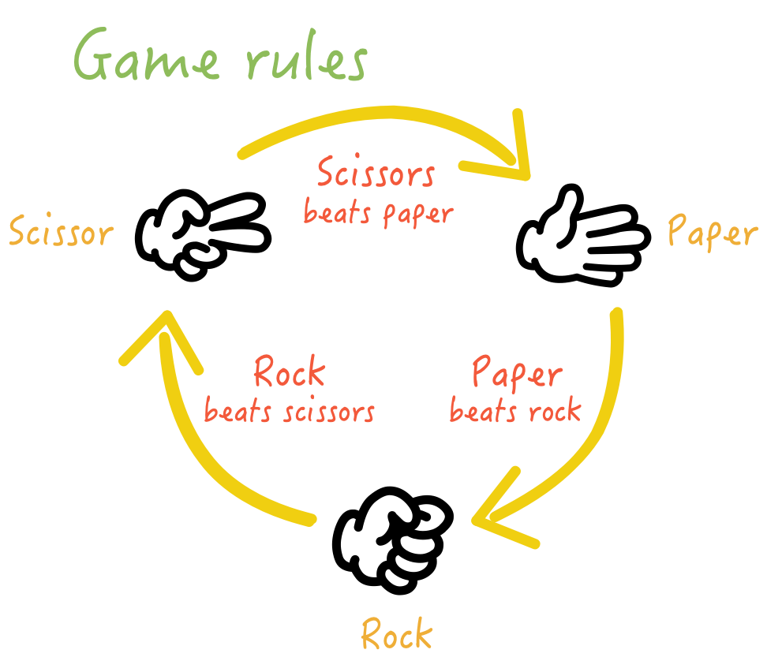
Option 2: Rock off (Pg. 20).
Clear space in the classroom (or step outside) and
mark out 5 progression stages for the competition.
Students are to line up at the start point.
The first two students will play off in a game of
Scissors, Paper, Rock.
The winner will progress to the next stage, the loser will
return to the end of the line.
The next pair will then rock off – the winner progresses,
and the loser goes to the back etc.
A student is the winner when they win at the final stage.
Notes:
Diagram of how to set it up on the next slide.
Each stage can be marked out using chairs, books, cones, tables etc.

Slide 11

Option 2: Rock off
Stage 1
Stage 2
Stage 3
Stage 4
Stage 5 – Final Stage
Winner progresses to the next stage and waits for their next opponent. The loser returns to the back of the line and awaits their next turn.
Notes:
Each stage can be marked out using chairs, books, cones, tables etc.

Slide 12
Option 2: Rock off reflection questions (Pg. 20).
How many games did you win + lose?
How did you feel after you won?
How did you feel after you lost?
How did you know when another person won a game?
How did you know when another person lost a game?
How did you deal with losing and what resilience skills did you use to build your resilience to keep going?
    Think back to the skills from activity 1.

